Slide 1
Dashboard Blueprint
Team 3

Slide 2
Analysis: Electric vs. Manual Bikes
As a team, we are considering a bike share business. We want to know if electric or manual bikes would be more popular among user.
To do this we take a sample datasource from CitiBike and perform our analysis.

Slide 3
About our Data
Our sample CitiBike trip data that includes the following:
ride id
latitude/longitude
member status
ride type
station information
time details
We will use our Machine Learning Model to predict if Electric or Manual Bikes are more popular among users

Slide 4
Final Dashboard Tools
The tools we will use to create the final dashboard will be Tableau.
Tableau is a visual analytics platform that transforms data into an engaging story for any audience.

Slide 5
Interactive Elements
Pie chart
Bar Chart

Slide 6

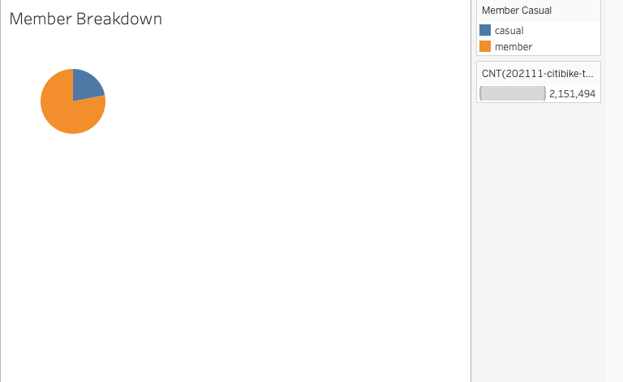
Images from initial analysis

Slide 7
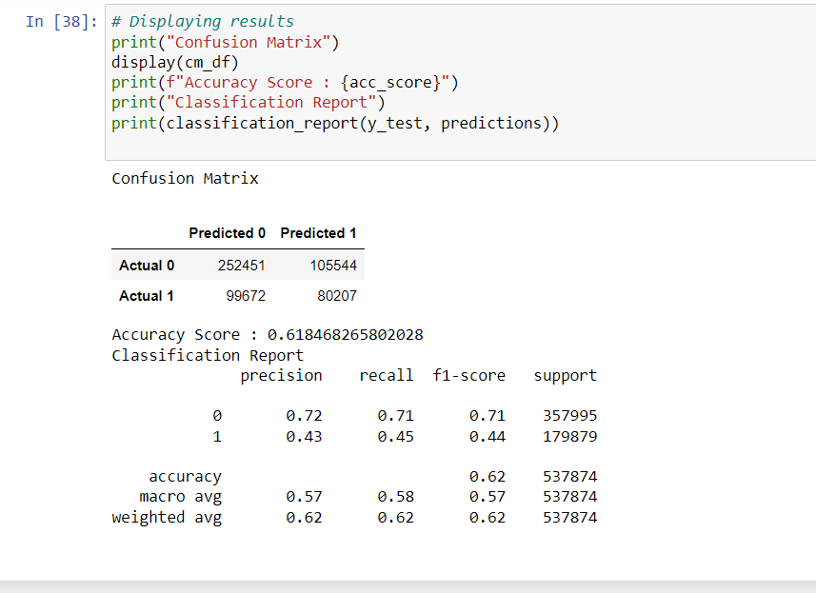
Data from the Machine Learning Task

Slide 8
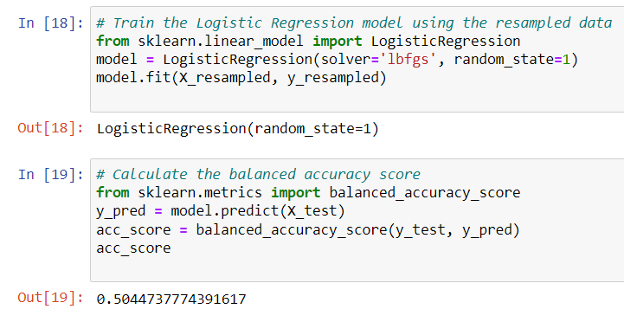

Slide 9
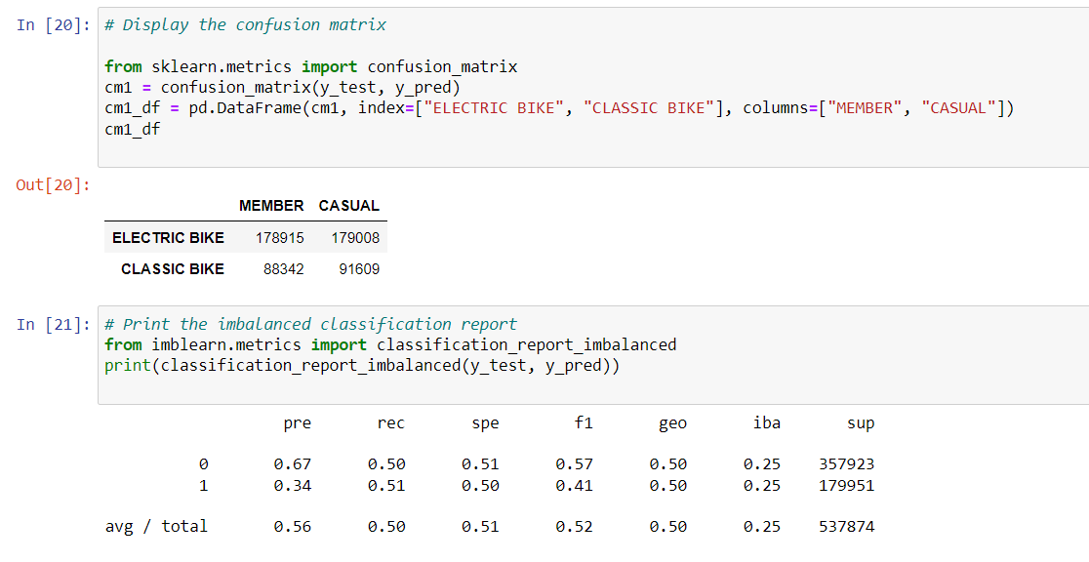

Slide 10
Interactive Element
[Paige’s tableau link]

